Slide 1
Traction – A Long Read LIMS
Harriet Craven
Steve Inglis
Notes:
Why: Steve
How: Harry
Now: Steve
Coming soon: Harry

Slide 2
WHY

Slide 3
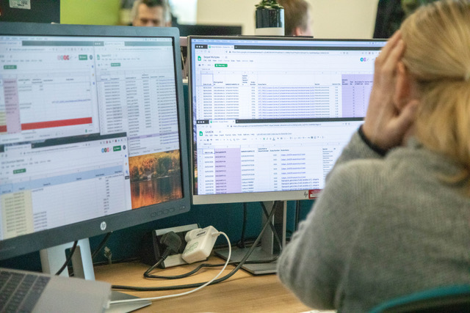
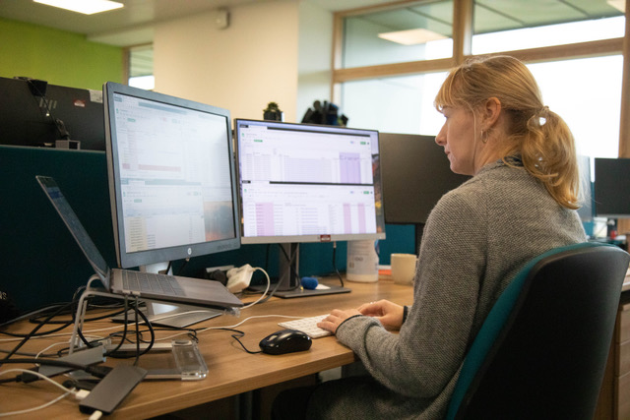
"We need a LIMS so that my full time job is not inputting info into Google Sheets"
“We have gone from tracking 10s of PacBio samples per month to trying to keep on top of >35 per month. When we start processing >35 per week it will be a close call between google sheets breaking or one of the team. Place your bets...”
Notes:
This is Karen. I have been in the same office as Karen for 3 years and throughout that whole time she has been crying out for a LIMS to track her work.
It has never been a priority because her work is bespoke and low throughput. She needs a LIMS so her full time job is not inputting info into Google sheets
That has all changed …
Craig: “We have gone from tracking 10s of PacBio samples per month to trying to keep on top of >35 per month. When we start processing >35 per week it will be a close call between google sheets breaking or one of the team. Place your bets...”

Slide 4
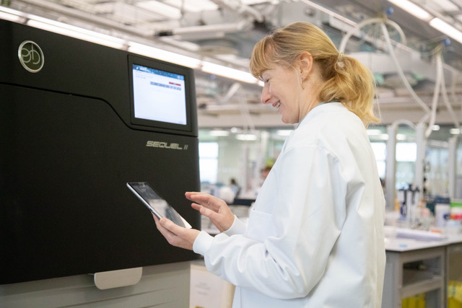
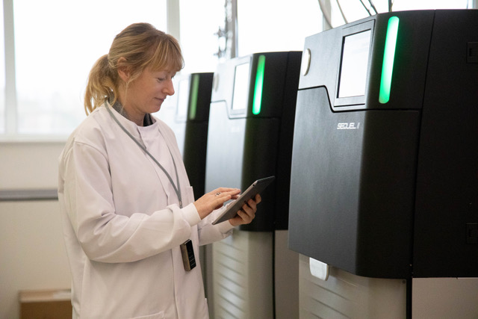
First there was Excel , then Google sheets, finally Traction
Notes:
This is how we envisage life for Karen with a LIMS which allows her to track her work.
In her natural environment; in the lab, looking happy and no Google sheets!
Just an iPad with LIMS and a 2D scanner.

Slide 5
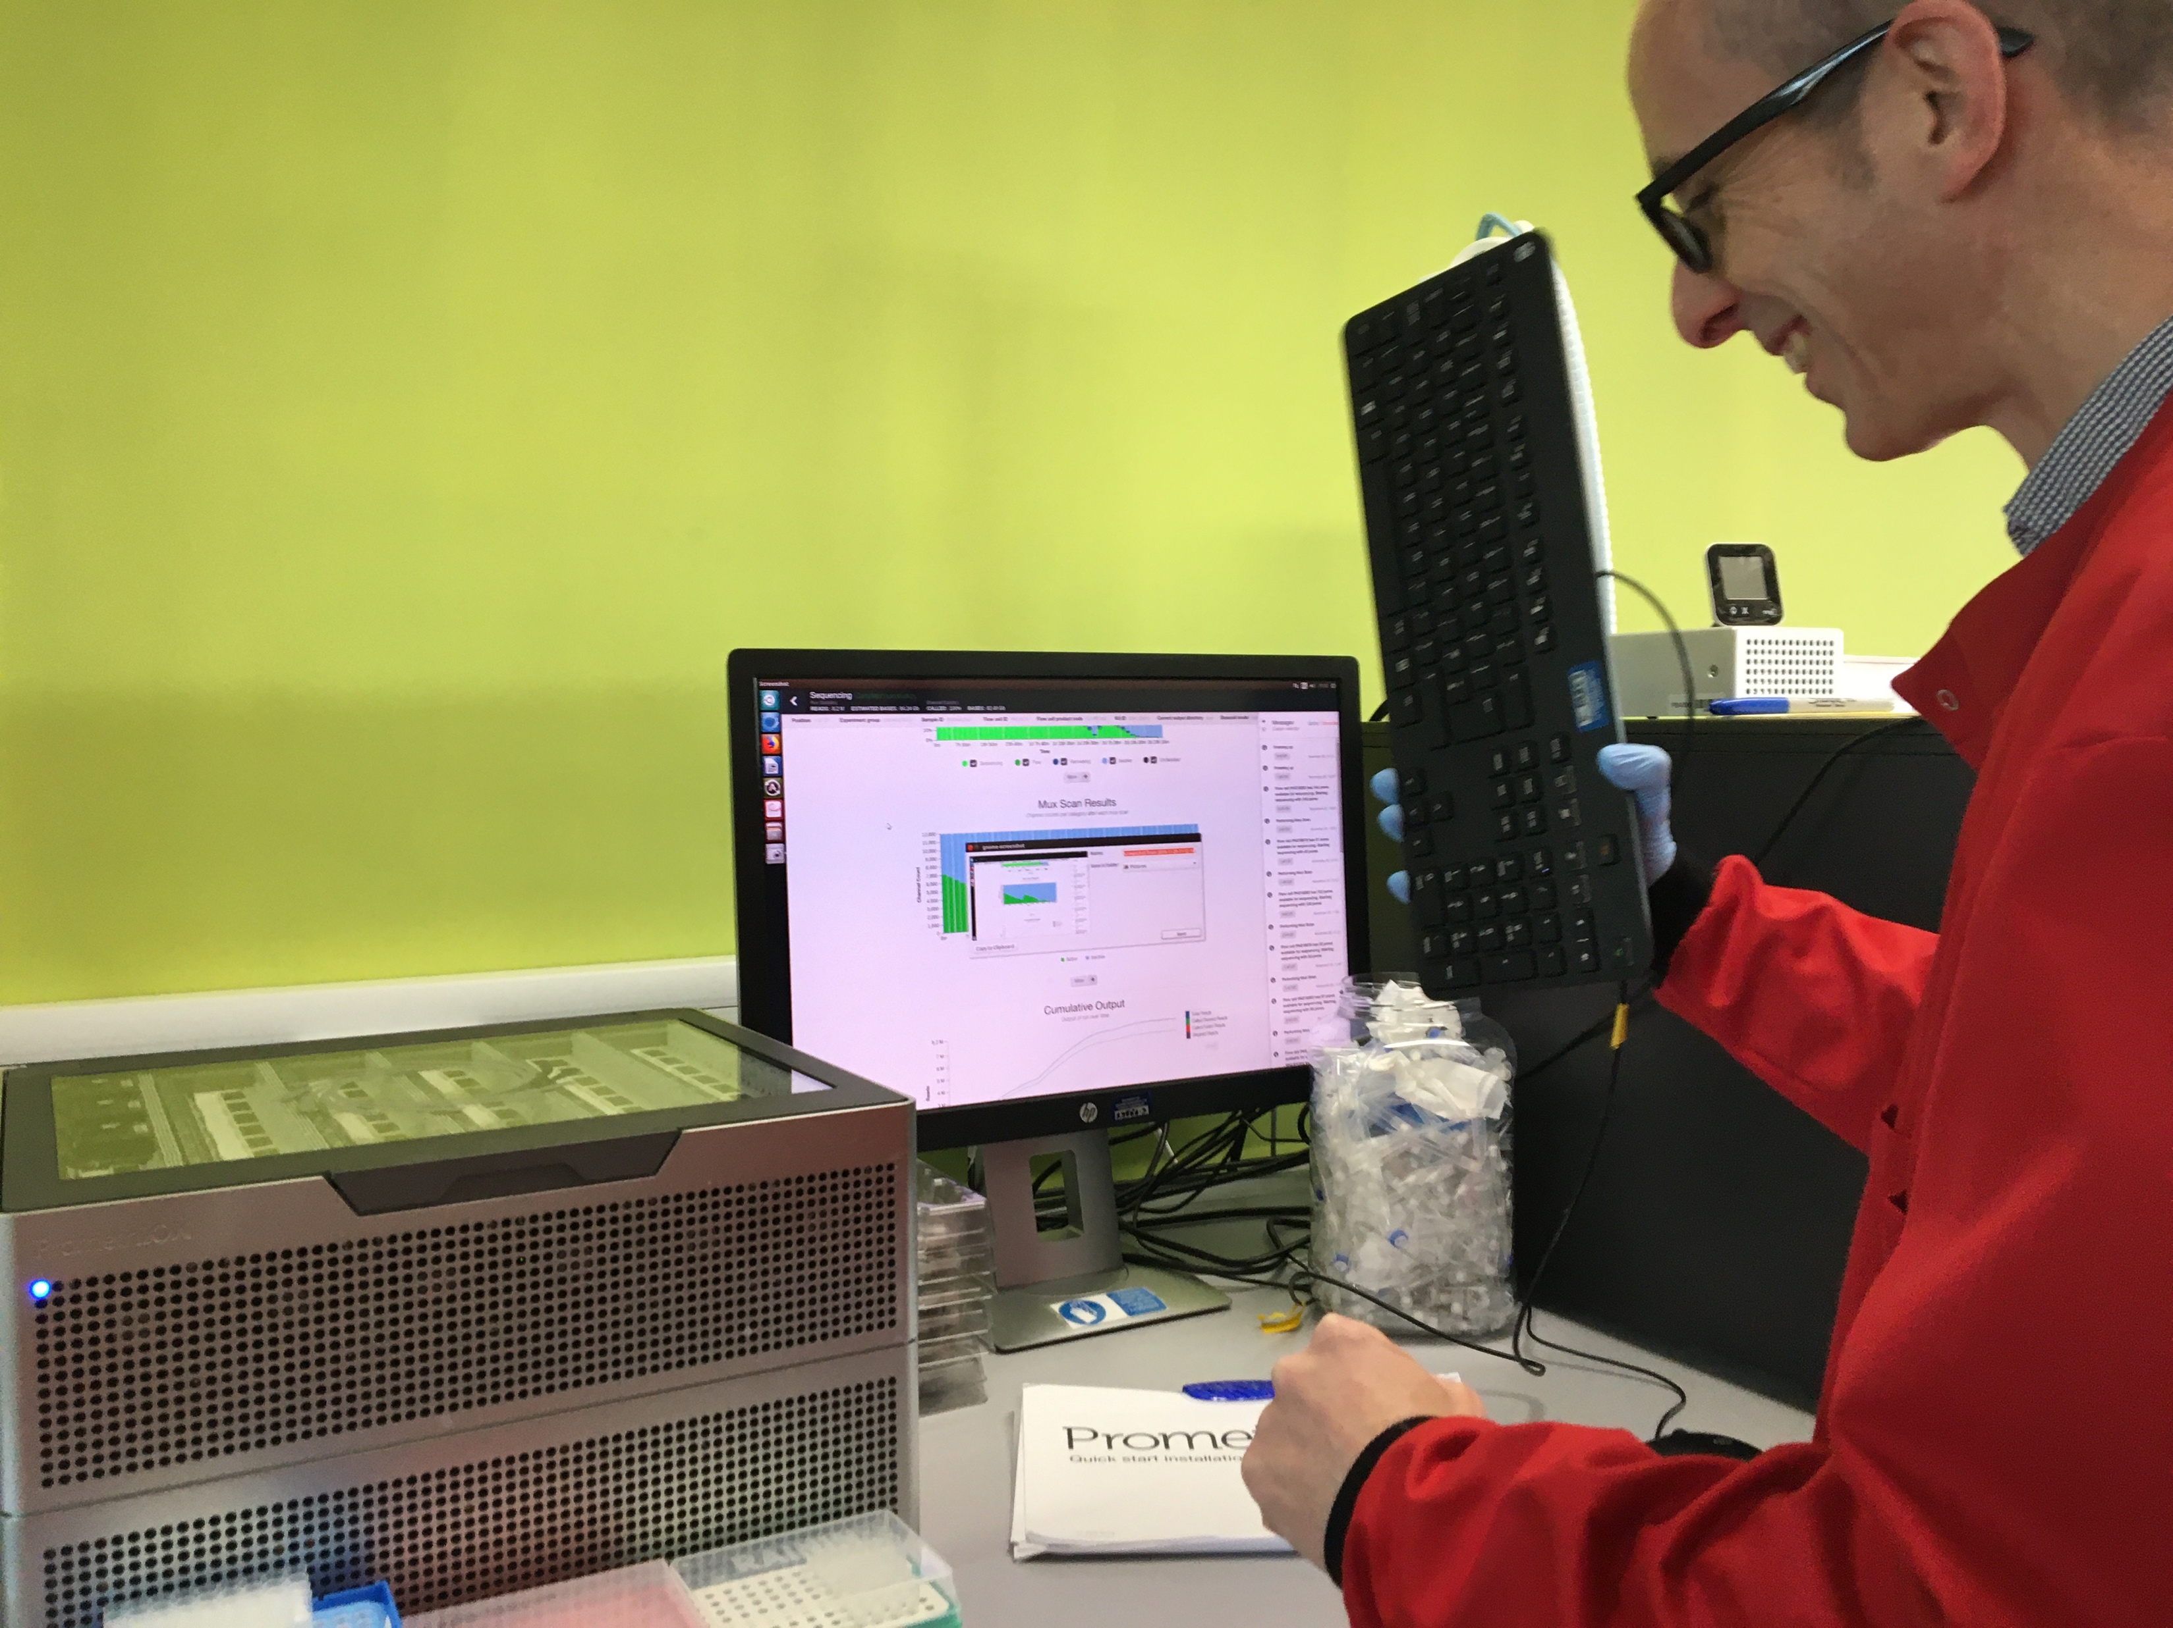
New Pipeline Group (NPG) | DNA Pipelines Informatics
We need to know what, when and where …
Notes:
This is Keith. Keith works in NPG.
He needs to be able to match sample data against the sequencing data. He also needs to make sure that they have got all of the data and what runs to expect. At the moment he has to do this manually and as you can see he gets frustrated. A LIMS will help him to gather the data in a more maintainable and less time consuming way.
No Promethions were hurt in the making of this image.

Slide 6
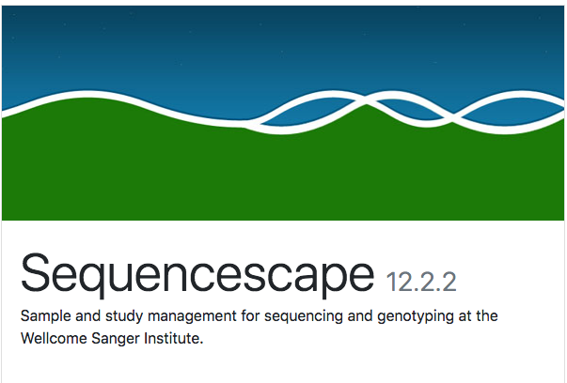
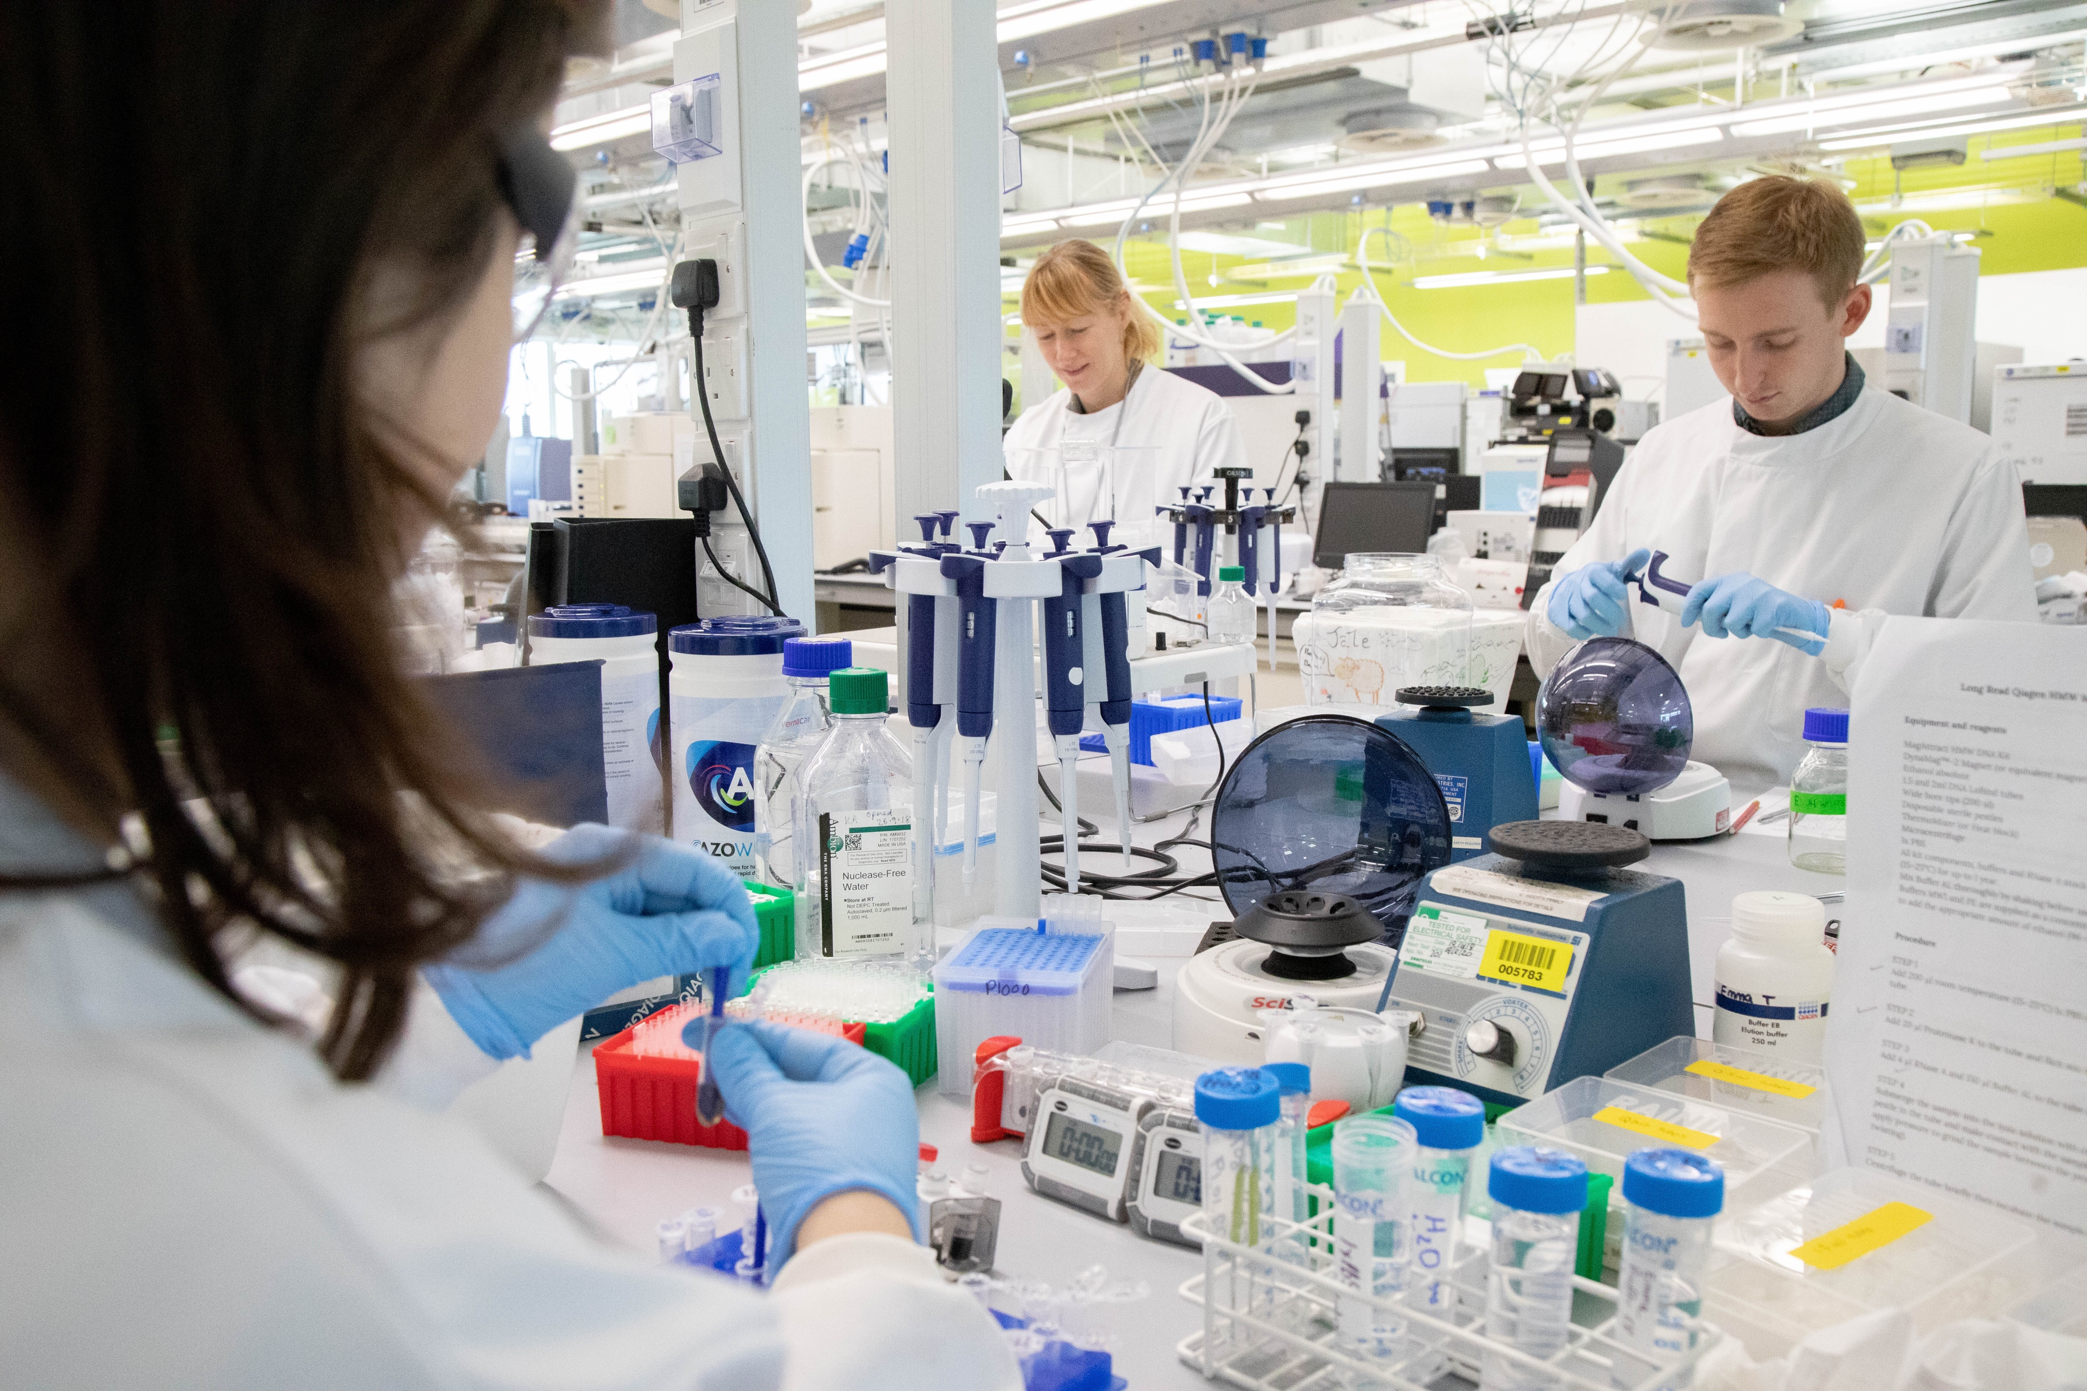



Faculty
R & D
Operations
External Partners
Notes:
Operations - Need a central place to track long read samples. Tree of Life – process 66000 samples over 10 years
Why not Sequencescape? Sequencescape models the short read domain well but does not work well for the long read model. We tried it with PacBio and it didn’t work.
R&D - With LIMS tracking they will have all of the historical data which we can be correlated with the sequencing data to give them an idea of how we can improve pipelines in the future.
Faculty – need to be able to correlate samples with output, need to know where samples are in the workflow and also need to know whether there is enough sample left for further analysis. They would also like QC information. With a LIMS we can provide them with that information easily.
External Partners - The Sanger Institute will serve as a hub for sequencing and genome assembly, annotation, data storage and data release. LIMS will be a crucial part of that.

Slide 7
HOW
Notes:
Now I’m going to talk about how we have implemented Traction so far

Slide 8
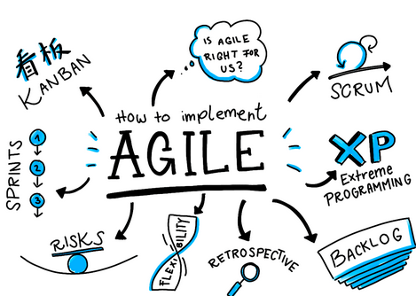
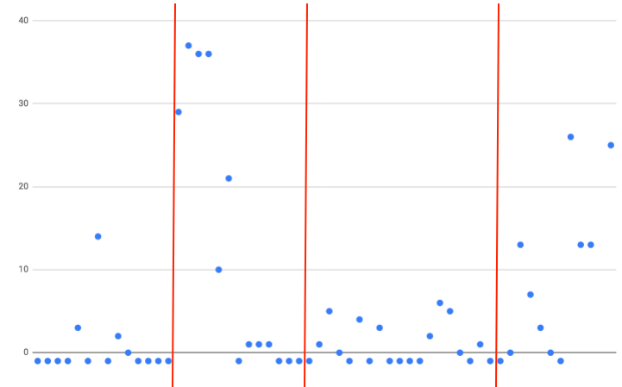
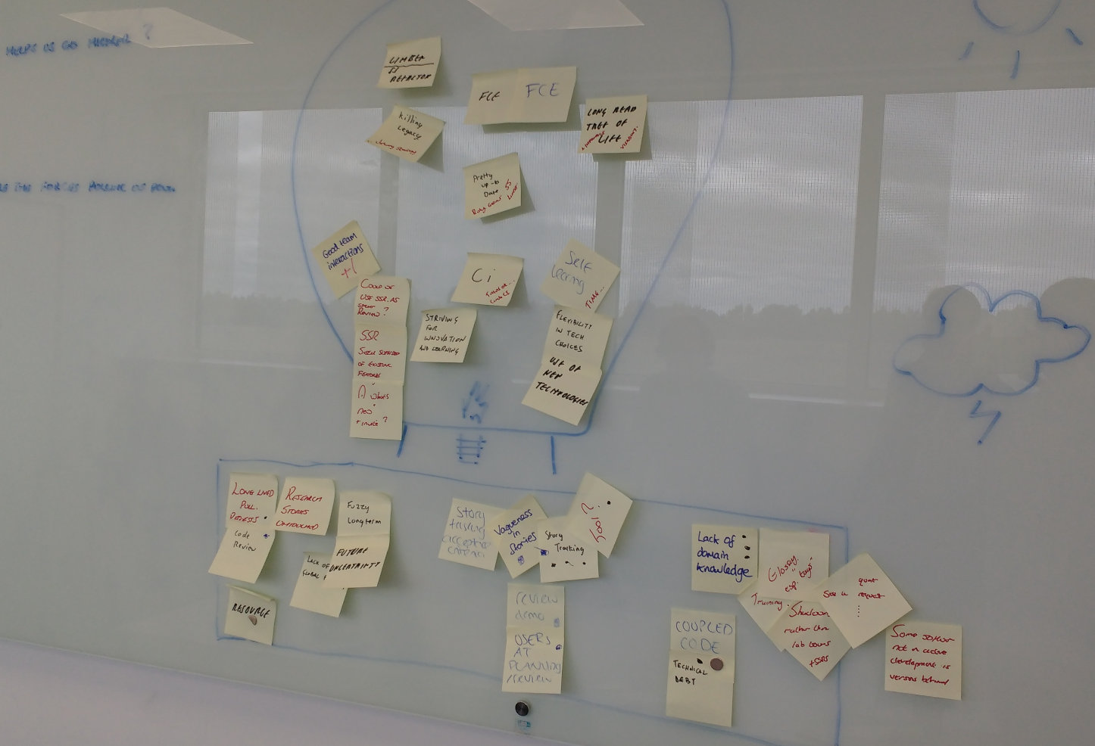
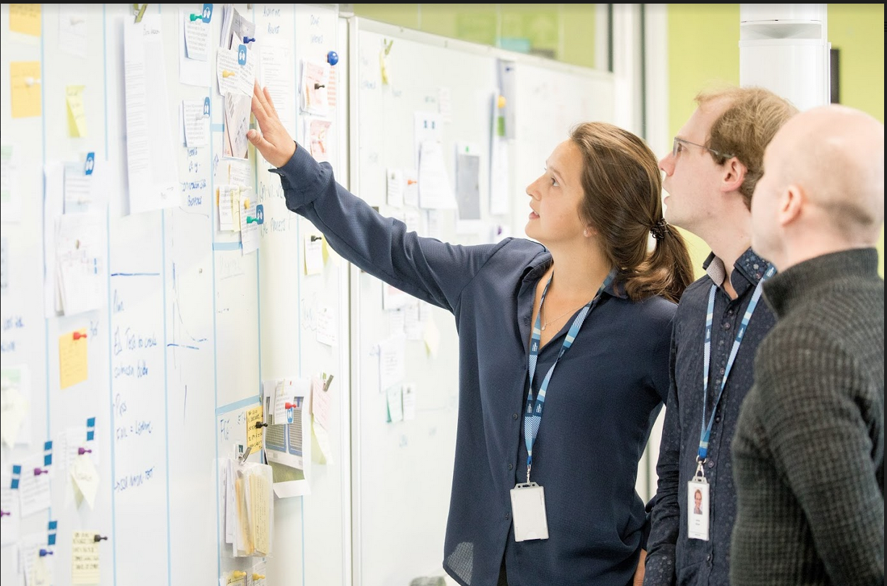
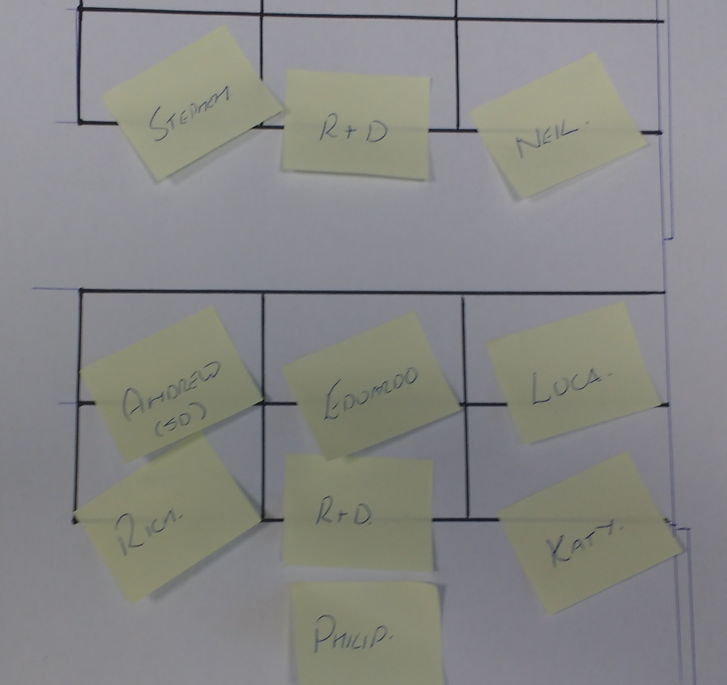
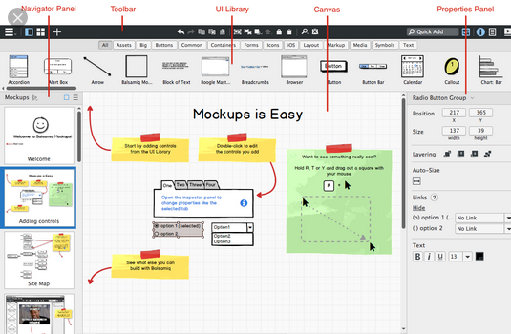
Development Process
Notes:
(As Rich mentioned/ To start with) our team uses an Agile development process
This means, we have a product owner, who prioritises new features.
As the development team, we then task up these features, or stories, sometimes making mock ups.
The code then gets reviewed, by another member of the team, before it is deployed to the FCE for user acceptance testing, and then finally, to production.
The scatter plot at the top of the screen shows our teams Cycle Time Metrics. This suggests, that for the most part, the team are estimating story size and complexity accurately, as we are delivering stories at a predictable and frequent pace.
This cycle repeats every two weeks, and we have daily morning stand ups to keep each other informed of progress, addressing any questions and queries.

Slide 9
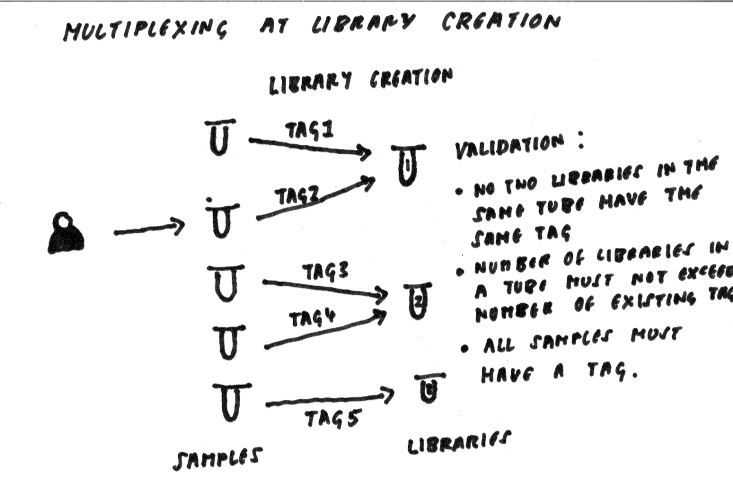
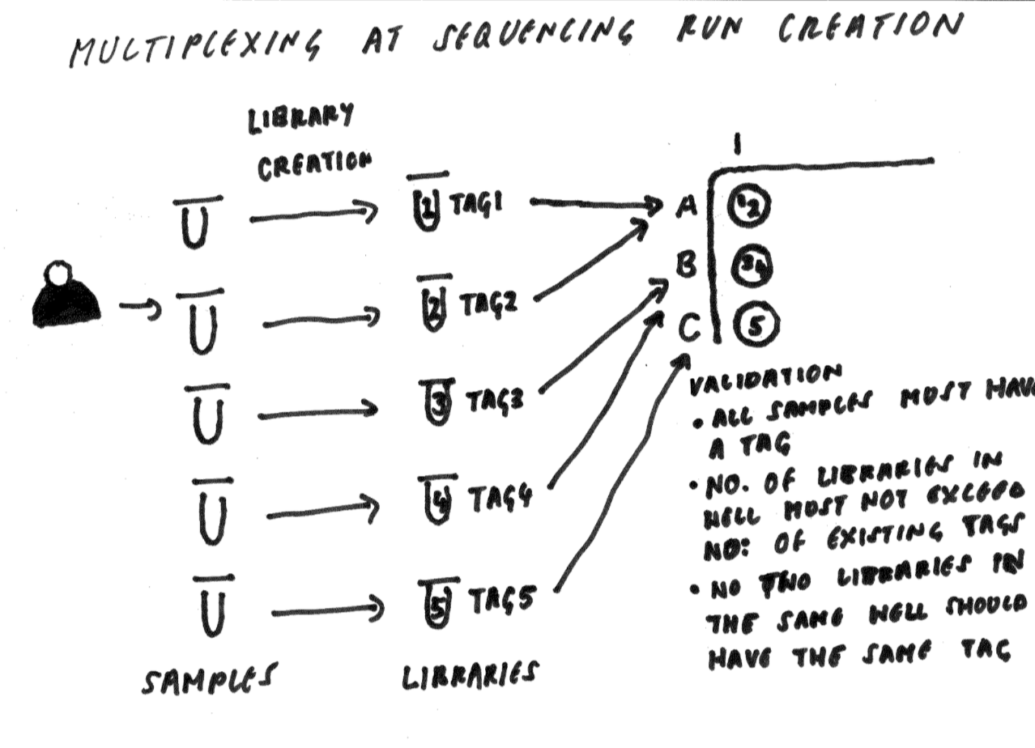
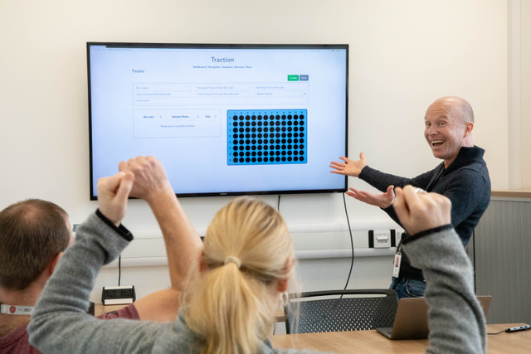
Customer Interaction
Notes:
Another aspect of our development is Customer Interaction
Throughout the two week cycle we try to get regular feedback from the users
For example, here, is a picture of Steve demo-ing a new feature.
We also meet to refine requirements, so we know exactly what the users require, and how Traction can deliver value.
The other diagrams were drawn, during a meeting with users, to clarify how multiplexing would be implemented in Traction
Craig, in the bottom left of the picture, said: We realised from this meeting, that they only needed to add Multiplexing at Sequencing Run creation, which saved both sides a lot of time and effort, and meant that we could get to MVP much quicker.

Slide 10



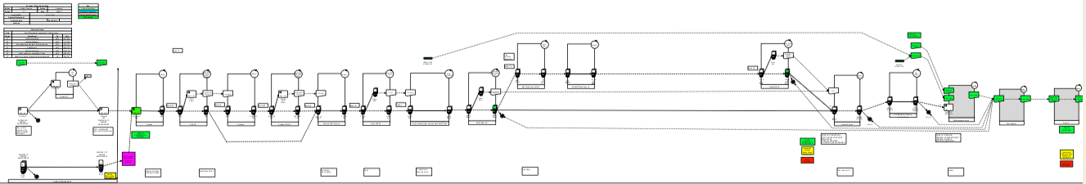
What we learnt to do better
Notes:
Of course, there are always things we can do better
We have recently created a Slack workspace which has meant communication over the two offices is much easier.
We have also be trying as a team to get into better habits of tasking out features, or stories, into smaller pieces, helping remove ambiguity from the start
As I’ve already mentioned, we are trying to improve customer interaction. During first release development, we made assumptions about the Traction process which was incorrect – they wanted Traction to be barcode driven. Hopefully, with better communication going forward, and drawing out process more thoroughly, we can slim the chances of this happening again.
On to, where Traction is at NOW

Slide 11
NOW

Slide 12
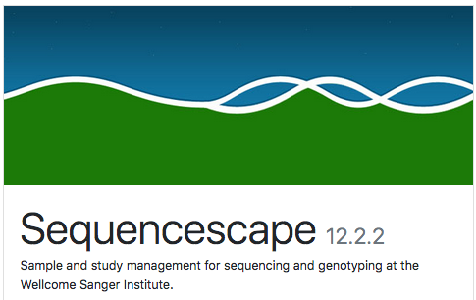

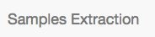

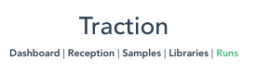
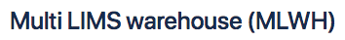
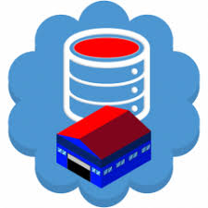
Architecture
Notes:
Sequencescape – Acts as a sample reception. Data provided by customers in sample manifest which contains associated metadata and allows samples to be attached to studies and projects. Used to record scientific objectives and data release policy. Receiving material from collaborators with material provenance ( porters value chain – inbound logistics).
Samples extraction – used to track samples through the DNA extraction process (porters value chain – operations)
Traction – used to track samples through long read pipelines. Will also be used to report on material progression and in the future to capture charging points. It will export the data to MLWH (porters – operations)
MLWH - Marshalling identifier information and product metadata to facilitate downstream processing (porters – outbound logistics)

Slide 13
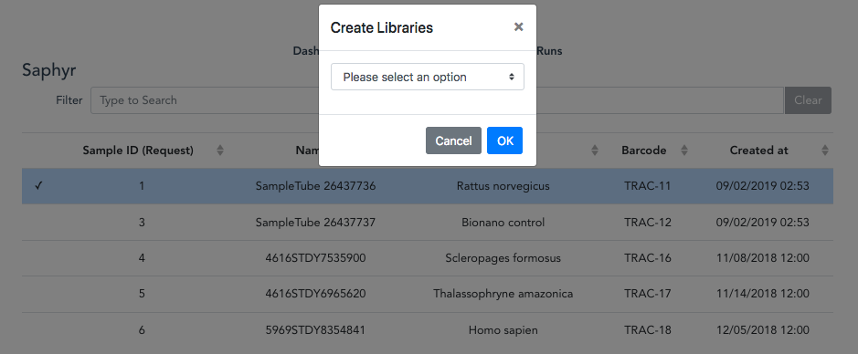
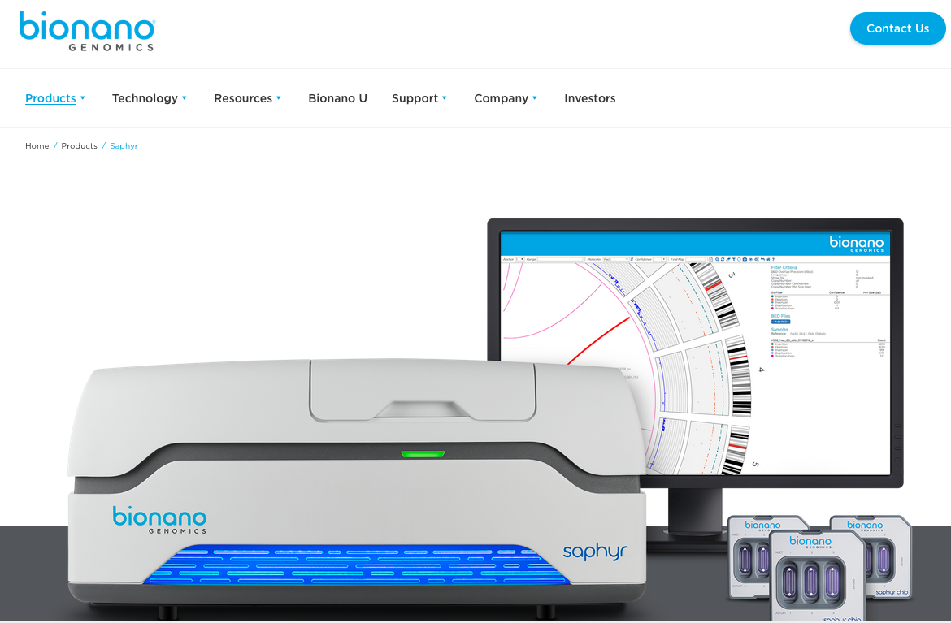
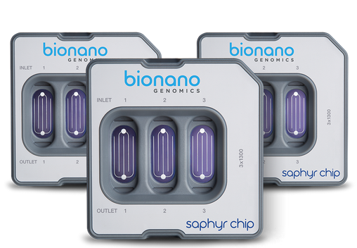
Saphyr
Notes:
Went live 6 months ago. Only 23 runs in Saphyr
Nothing recently because of Saphyr instrument faults The software has recently been updated which allows a bigger throughput per chip and they are going to do a troubleshooting run to ensure the instrument is working ok. The problem could be related to samples, chip or reagents so the plan is to recommence samples so hopefully the pipeline could be up and running again soon.
Traction allows you to - Import samples from samples extraction, create libraries, create sequencing runs and export data to the MLWH

Slide 14
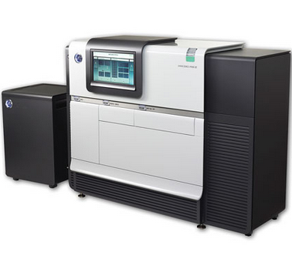
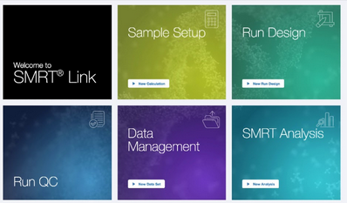
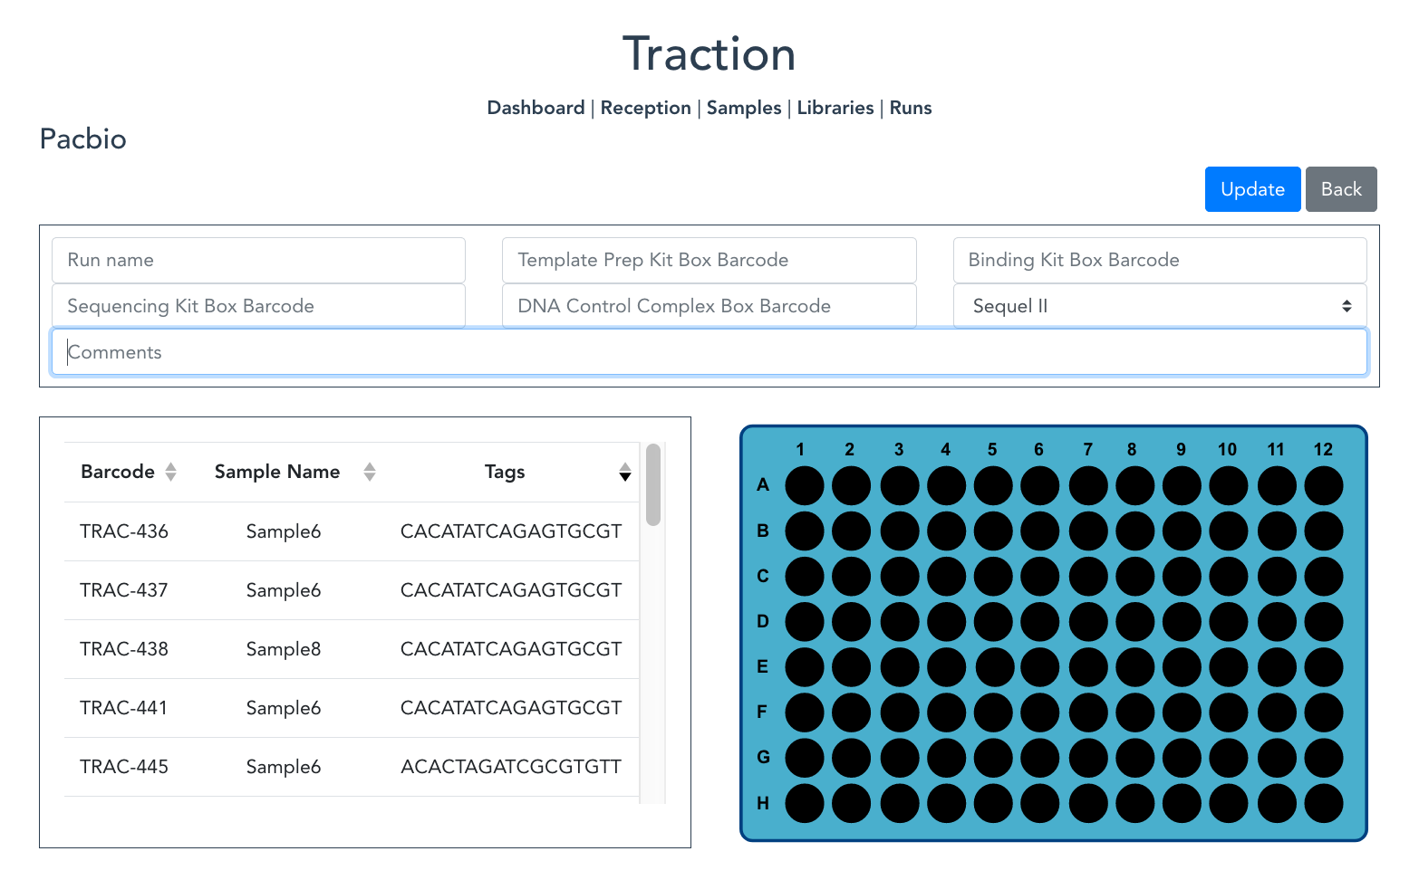
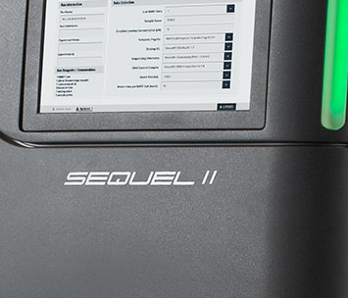
Pacbio
Notes:
Traction allows them to:
Import samples from samples extraction
Create libraries
Create runs
Generate sample sheets for importing into SMRT link
when a run is created data is automatically exported to the warehouse
Went live on November 21st
First 2 samples were created on November 27th
Libraries should be created this week
First run in before Christmas

Slide 15
COMING SOON
Notes:
So, what is coming next for Traction!?

Slide 16

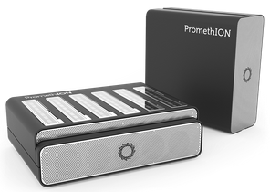
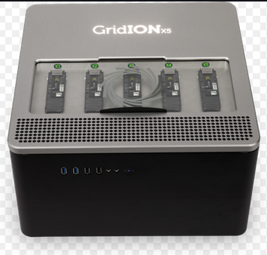
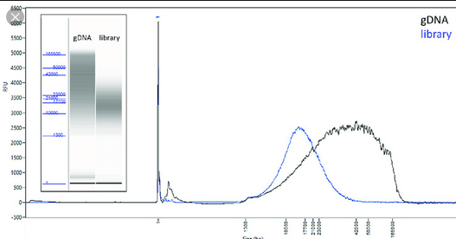
ONT and Pacbio
Notes:
We are currently implementing the Pacbio multiplexing support, you saw being designed earlier. This will be released before the end of the year.
In January, we are hoping to add further tracking support for QC, and the storage of Femto Pulse images.
After that, we hope to add support for other Oxford Nanopore Technologies, specifically Promethion. Genomic England have expressed they are looking to scale up their Promethion work, so there might some cool collaboration there.
Finally, we hope to add automation using the instruments API. As through put increases, this will become crucial to prevent duplication of work for the users, for example, when creating a run. Integration with the instruments API would also allow Traction to extract information about a runs progress, proving live updates in Traction.

Slide 17
THANK YOU
Notes:
That’s all from us. Thank you for listening.
We will now pass you onto Andrew, who will concentrate on the science and processes.

